Slide 1

Comparative analytics project between New York City and Toronto
What makes a city unique

Slide 2
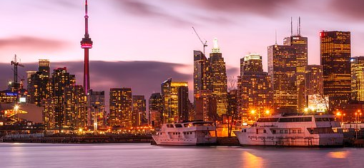
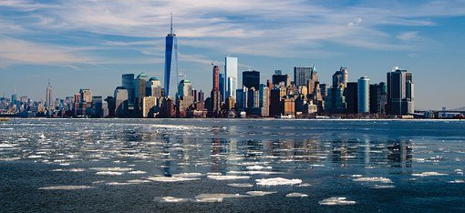
New York City vs. Toronto

Slide 3
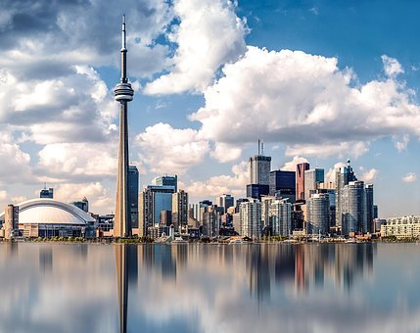
Data and Methodology
Data: Foursquare location data & Toronto geographical data & New York geographical data
Method: Clustering, K means method, Comparative analytics

Slide 4
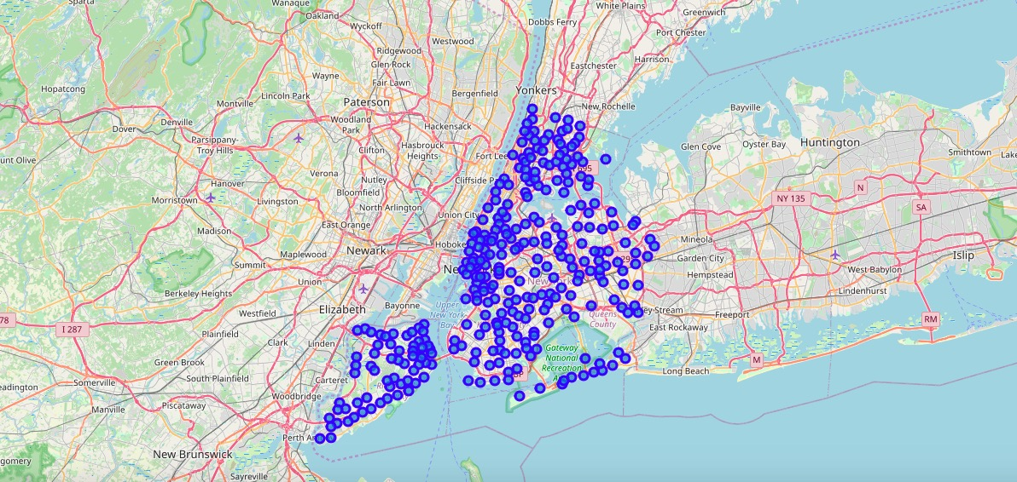
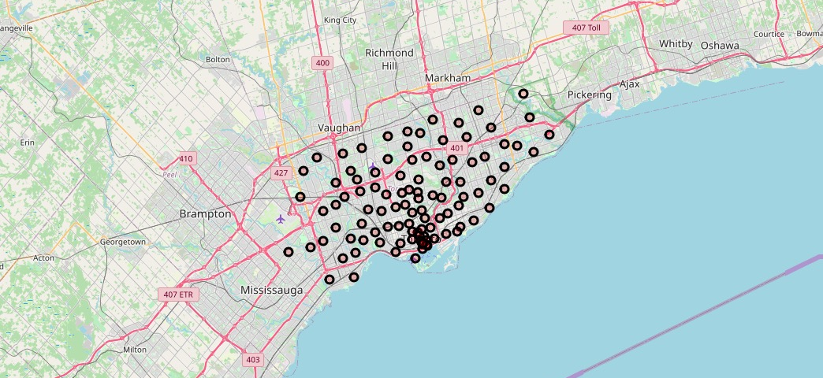
Neighborhood distribution in two cities
New York: more population, larger areas,
more neighborhoods, higher population density than Toronto

Slide 5
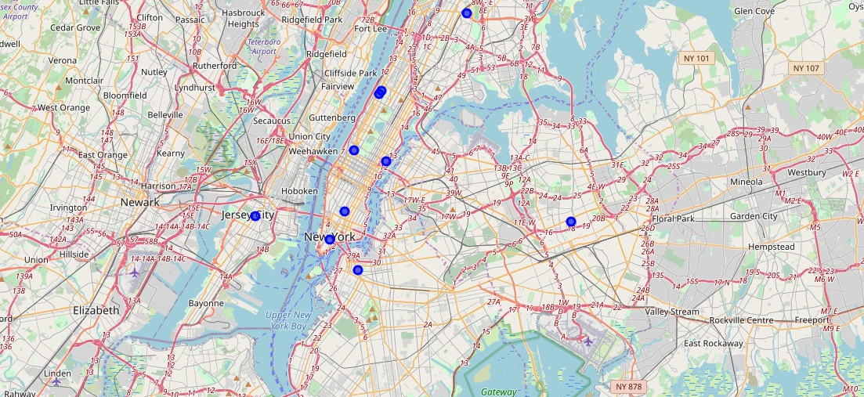
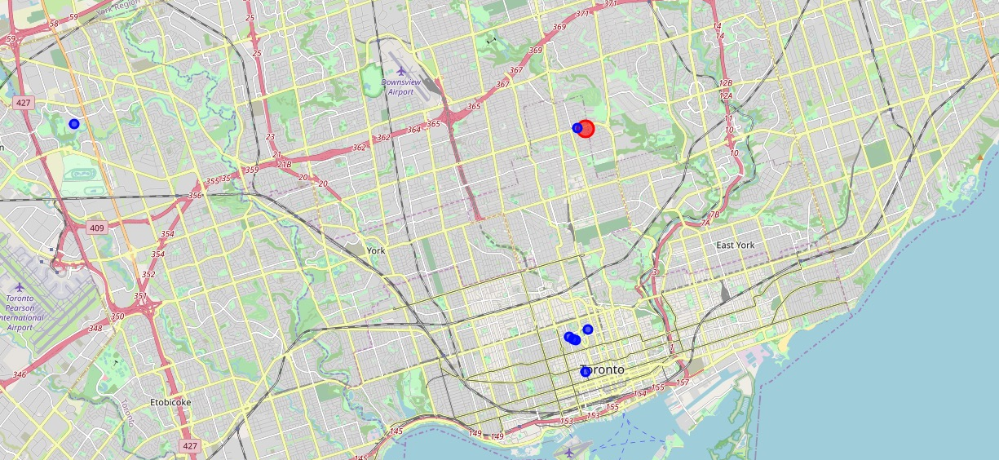
University Distribution
Universities in New York City are assessible and distributed more uniformly than universities in Toronto

Slide 6
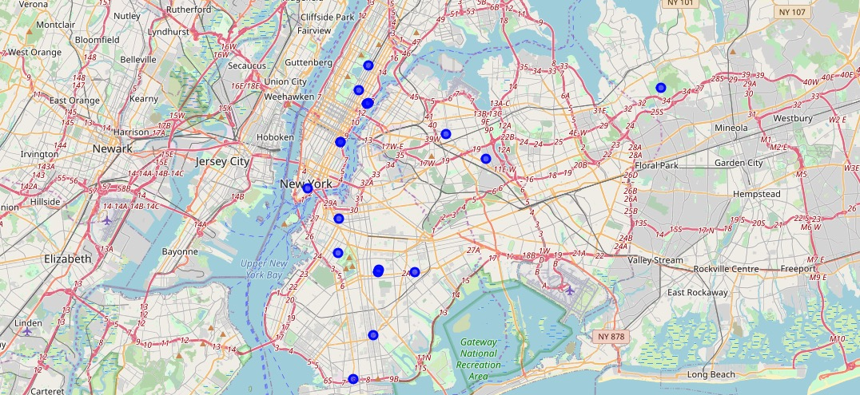
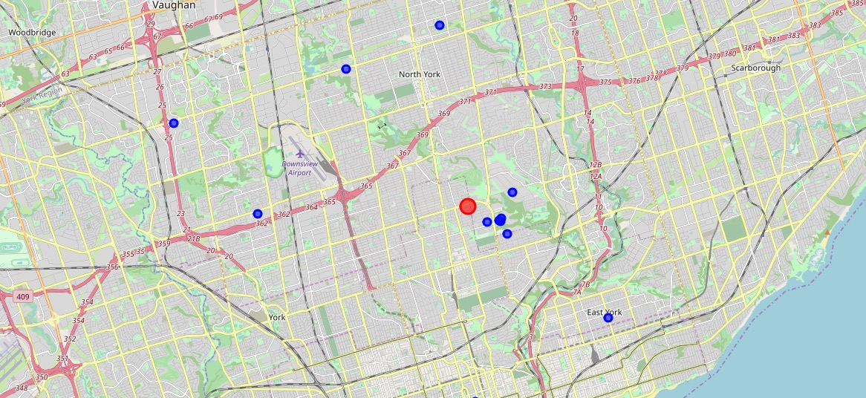
Hospitals Distribution
Hospitals in New York City and Toronto are almost equally assessible and distributed uniformly in both cities.

Slide 7


Clustering analytics
For the sake of simplicity, we choose the most developed and populous borough in each city (Manhattan and Downtown Toronto) and utilize one of data science techniques aka k – means – clustering to group all the neighborhoods within these two boroughs together.

Slide 8
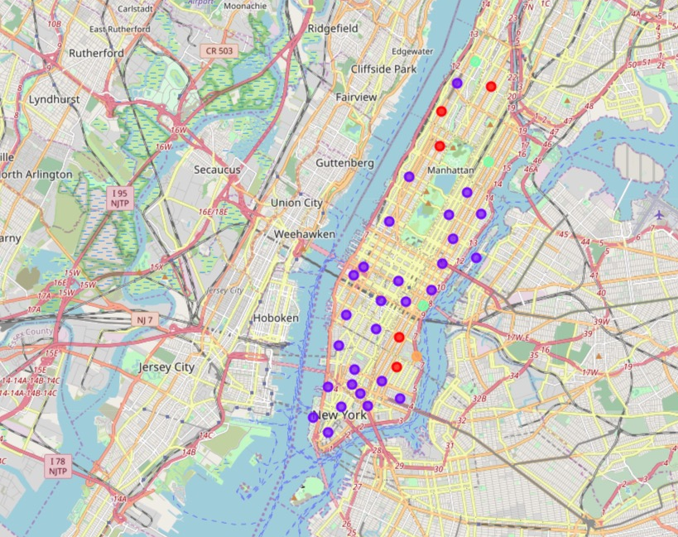
Clustering analytics for Manhattan
The first cluster which marked by red color, contains the following five neighborhoods: Central Harlem, East Village, Manhattan Valley, Morningside Heights and Gramercy. They are recognized by having bars, all kinds of restaurants and coffee shops. The second cluster is marked by purple color contains more than 20 neighborhoods and they are mainly based on south of Manhattan. The third cluster only contains one neighborhood and it is also the most north neighborhood. There is one special cluster which is near the sea, it is Stuyvesant Town, and the 1st most common venue in this neighborhood is Boat or Ferry, the 2nd most common venue is park, so this place could be a place where tourists could enjoy. The final cluster contains also 5 neighborhood and it extends from north to south. It has a lot of different café, restaurants and park for people to relax.

Slide 9
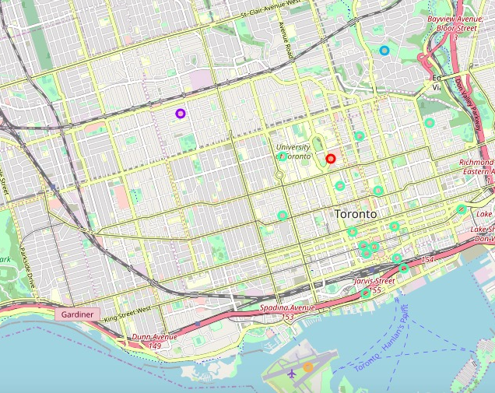
Clustering analytics for Downtown Toronto
We could see the first cluster is neighborhood Queen’s Park, Ontario Provincial Government, which is marked in red color, the most three appeared venue in this cluster are coffee shop, diner and sandwich place. The second cluster also contain only one neighborhood which is Christie which is marked in purple. The most appeared venues for neighborhood are grocery store, care and park. The third cluster only contains one neighborhood which is Rosedale marked in blue. The most appeared venues for neighborhood are park, playground and trail, so this area must be a great place for tourists to explore. The fourth cluster contains the largest number of neighborhoods in Downtown Toronto. The most appeared venues for these cluster are highly likely coffee shop, café, bar and restaurants, so this is definitely a place for food lovers. The last cluster also only contain one neighborhood which could be referred to as “financial district”. It is marked by yellow color. It is also near to the sea and have a ferry and airport.

